Slide 1
PROJECT RECYCLE ANALYSIS OF WASTE MANAGEMENT SYSTEM IN THIRUVANANTHAPURAM MUNICIPAL CORPORATION
A Project by
Team BitPlease
Tech Department of Sahridaya

Slide 2
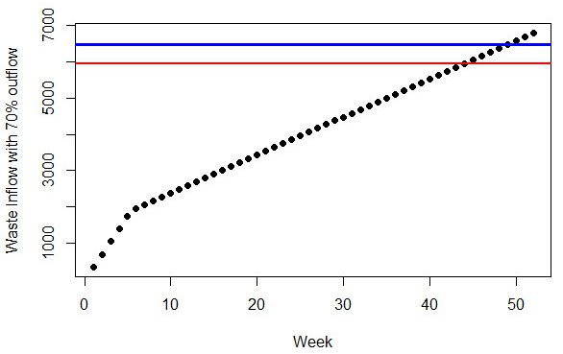
Waste Inflow and Outflow with weeks
Waste deposited in aerobic bin/ ward
Average waste/ ward/ week
Overflow limit

Slide 3
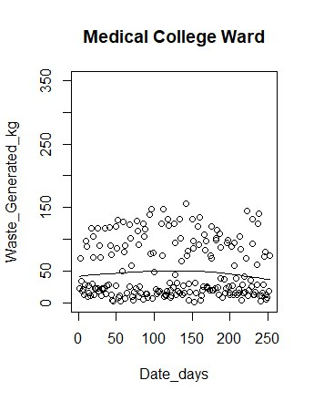
Regression analysis of Current waste generation in Medical College ward

Slide 4
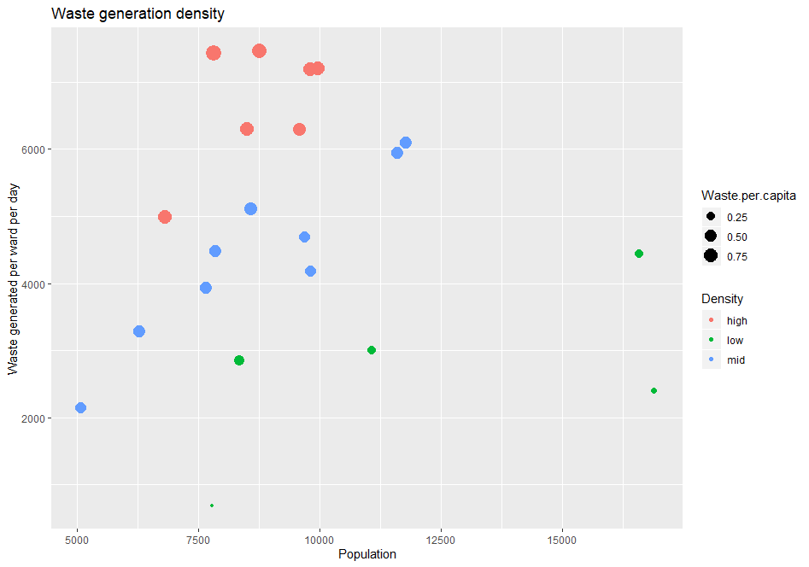
Ward | Population | Waste generated | Waste per capita | Density
Vattiyoorkavu | 9967 | 7200 | 0.722384 | high
Ulloor | 11599 | 5940 | 0.512113 | mid
Palayam | 5069 | 2148 | 0.423752 | mid
Medical College | 6817 | 4986 | 0.731407 | high
Manacaud | 7853 | 4476 | 0.569973 | mid
Jagathy | 8348 | 2850 | 0.341399 | low
Sreekaryam | 11782 | 6096 | 0.517399 | mid
Kazhakkuttam | 16882 | 2400 | 0.142163 | low
Sasthamangalam | 9810 | 7182 | 0.73211 | high
Thirumala | 8750 | 7470 | 0.853714 | high
Thiruvallom | 16580 | 4446 | 0.268154 | low
Vizhinjam | 8498 | 6300 | 0.741351 | high
Karamana | 9810 | 4182 | 0.4263 | mid
Fort | 6296 | 3282 | 0.521283 | mid
Nemom | 8576 | 5112 | 0.596082 | mid
Kudappanakkunnu | 9576 | 6300 | 0.657895 | high
Nanthancode | 9677 | 4692 | 0.484861 | mid
Sreekandeswaram | 7661 | 3936 | 0.513771 | mid
Kadakampally | 11075 | 3006 | 0.271422 | low
Poonthura | 7825 | 7434 | 0.950032 | high
Chalai | 7788 | 684 | 0.087827 | low

Slide 5
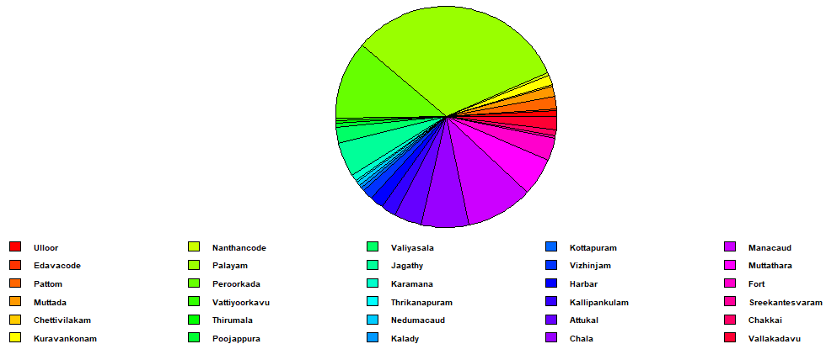
Waste Processing Index

Slide 6
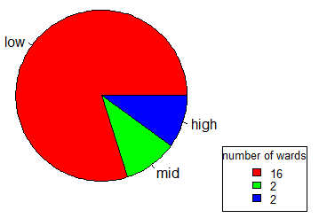
Growth Index

Slide 7
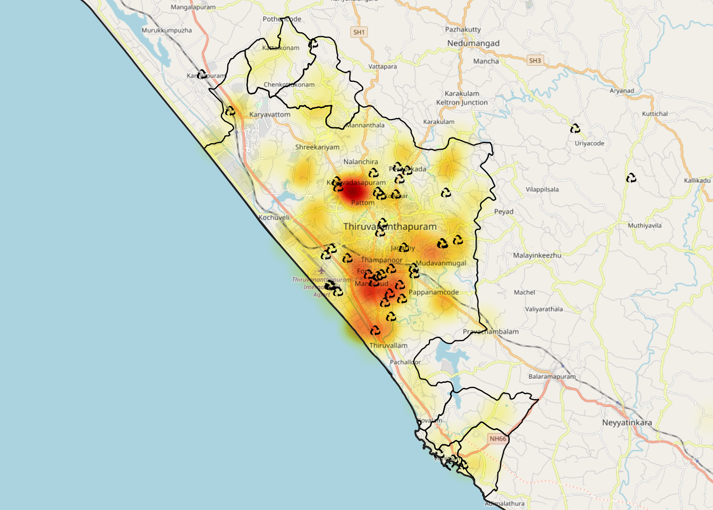
Population density

Slide 8
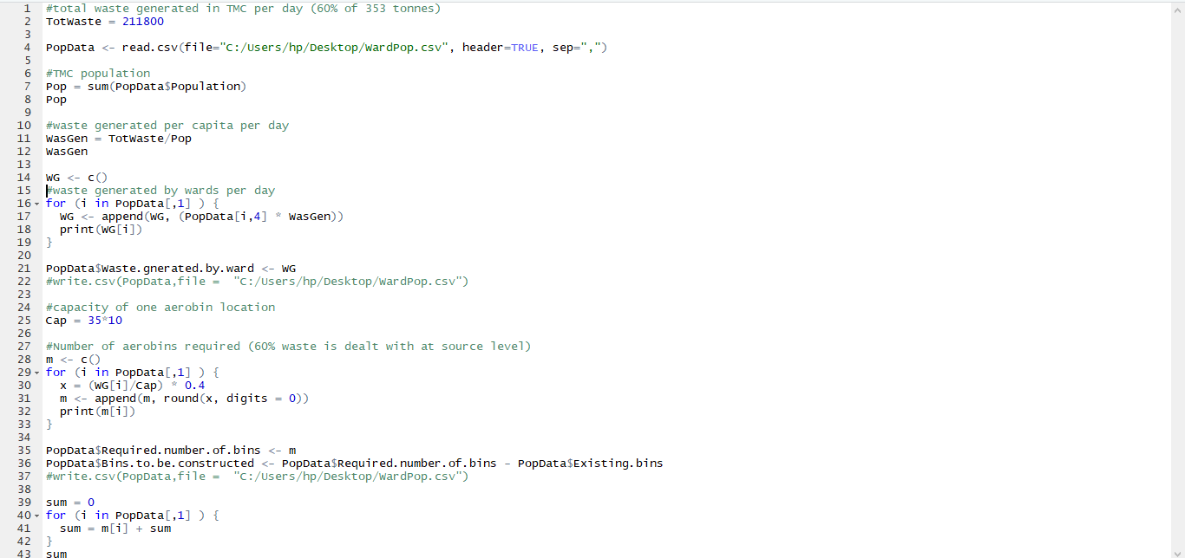
R Code for Mathematical Model

Slide 9
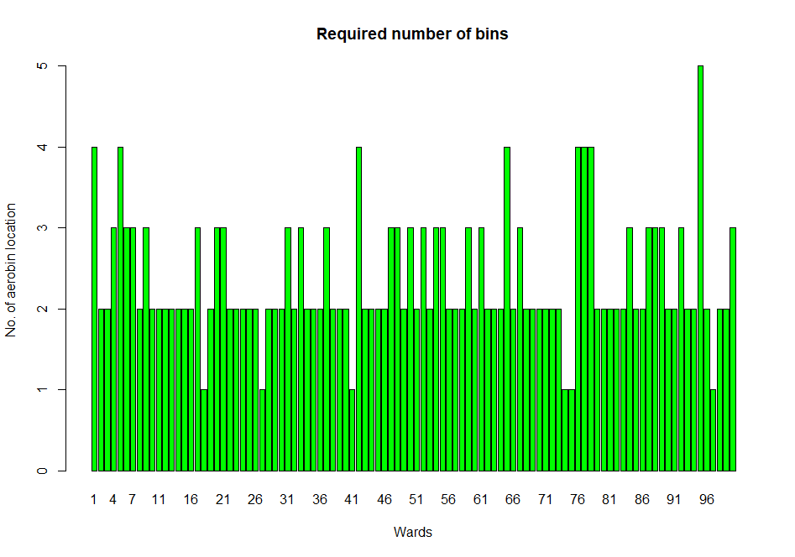

Slide 10
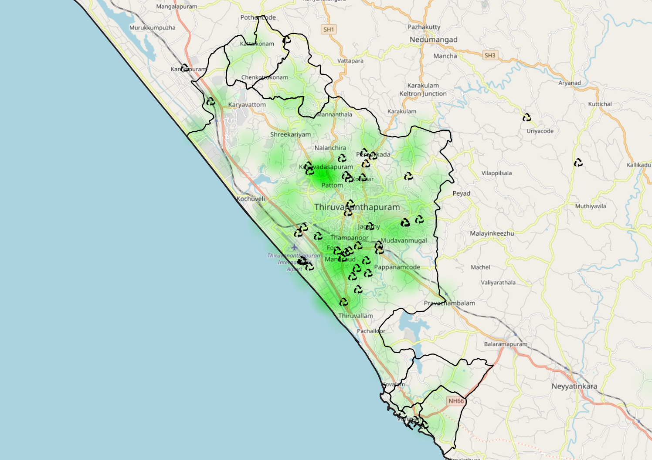
Waste generation density and location of aerobic bins

Slide 11
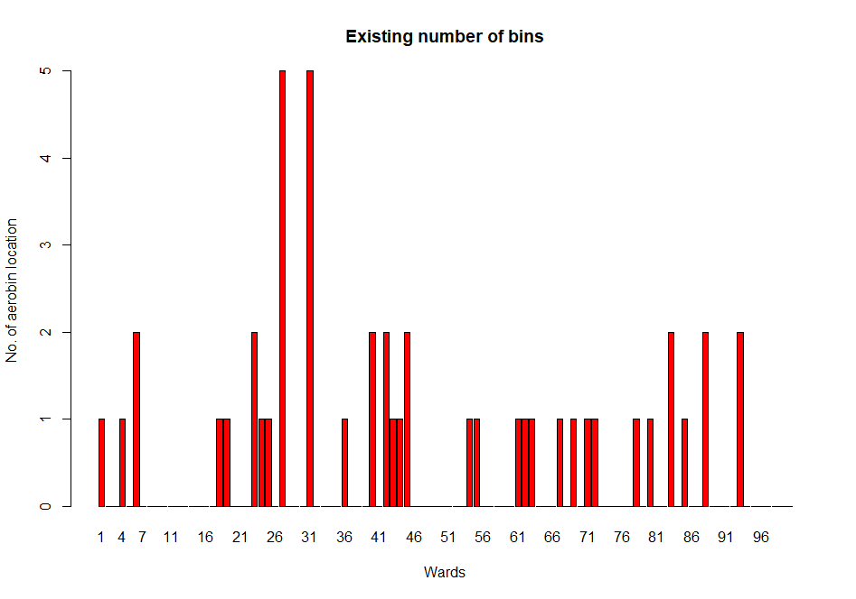

Slide 12
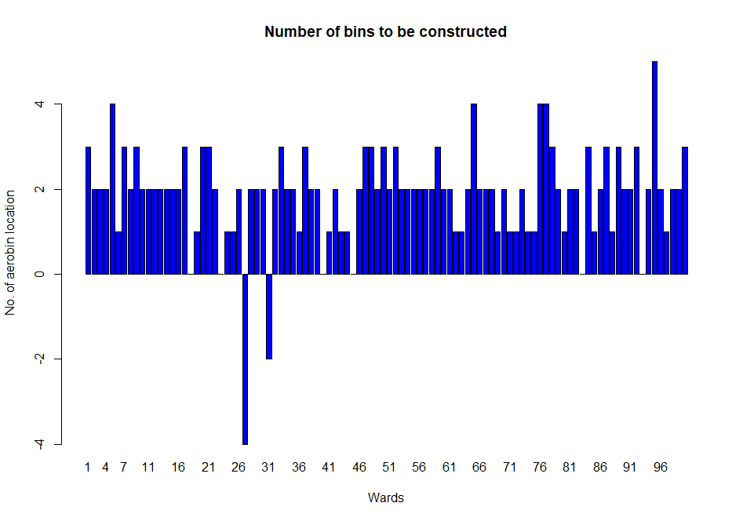

Slide 13
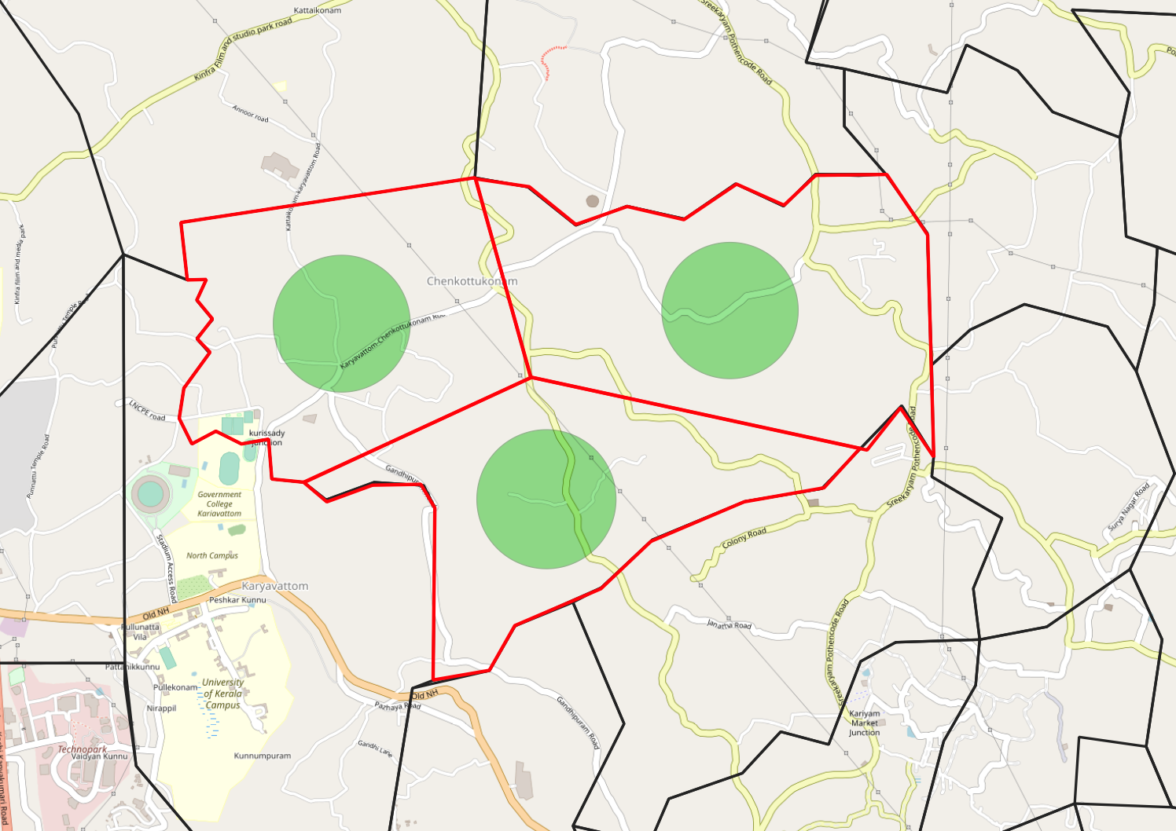
Represents the range within which the aerobin should be placed.
Represents division of ward area.

